Slide 1


Introduction to Domestic Violence:
One Hour Training for Medical Professionals
National Prevention Toolkit on Domestic Violence for Medical Professionals

Slide 2
Overview
This training educates medical professionals about the dynamics and impact of domestic violence. We use the term “domestic violence” to refer to the following:
Domestic violence is an epidemic in the United States that is not only pervasive, but also extremely costly in human and financial capital.
It is a serious public health problem that can be prevented.
- Interpersonal Abuse | - Relationship Abuse
- Dating Violence | - Domestic Abuse
Notes:
Futures Without Violence
CDC: IPV

Slide 3
Overview (continued)
It affects victims, as well as families, children, friends, and communities.
Victims are affected physically, as well as mentally, during and after abuse.
Providing victims with information and connection to resources in the community can help prevent further abuse.
Every medical professional will encounter victims of domestic violence.
Notes:
Futures Without Violence
CDC: IPV

Slide 4
Objectives
After completing this training, medical professionals will be able to do the following:
Understand the dynamics and impact of domestic violence.
Know the prevalence and incidence of domestic violence in the United States.
Recognize batterer behaviors.
Be aware of the risk factors among perpetrators and victims.

Slide 5
Objectives (continued)
Understand the physical and mental health consequences of domestic violence.
Understand some of the reasons why victims stay.
Learn ways to become part of the solution to end domestic violence in your community.
Understand myths associated with domestic violence.
Understand interventions to help domestic violence victims.

Slide 6

State Laws
Every state defines domestic violence differently, pursuant to code or statute.
Every medical professional should be familiar with the state laws regarding domestic violence and any mandatory reporting laws.
View our Resource Page for a list of state laws about domestic violence.
www.dvmedtraining.csw.fsu.edu/resources

Slide 7
What is domestic violence?
  A descriptive, non-legal definition of domestic violence is:
  “the pattern of abusive behavior in any relationship that is used by one partner to gain or maintain power and control over another partner.”
  It can happen to anyone regardless of race, age, education level, sexual orientation, occupation, religion, or gender.
  Domestic violence can occur in an intimate, co-habiting, dating, engagement, marriage, post-separation, or post-divorce relationship.
  Some domestic violence acts are not considered crimes on their own, but all contribute to a pattern of behavior that seeks to control victims.
Notes:
Family Violence Across the Lifespan

Slide 8
The Public Health Crisis of
Domestic Violence
According to the US Centers for Disease Control:
24 people per minute are victims of rape, physical violence, or stalking.
More than 1 in 3 women and 1 in 4 men have experienced rape, physical violence, and/or stalking by an intimate partner.
1 in 10 women have been raped by an intimate
partner.
1 in 4 women experience severe physical violence.
10.7% of women are stalked by an intimate partner.
Notes:
CDC: NISVS 2010 Summary Report (in white)

Slide 9
The Public Health Crisis of
Domestic Violence (continued)
Nearly half of all female victims are psychologically abused.
3 in 10 women who have experienced rape, physical violence, and/or stalking reported at least 1 impact:
    Fear, concern for safety, PTSD, need for health care, injury, contacting crisis hotline, need for housing, advocate services, legal services, missed work or school.
Victims of severe domestic violence collectively lose nearly 8 million days of paid work.
In 2010 1,095 women were murdered by an intimate partner.
Notes:
CDC: NISVS 2010 Summary Report (in white)

Slide 10
The Financial Cost of
Domestic Violence
In 2003 alone, the cost for medical and mental health services and lost productivity was equal to 8.3 billion dollars.
  Cost of rape = $460 million
  Cost of stalking = $461 million
  Cost of lives lost = $1.2 billion
  Cost of physical assault = $6.2 billion
These costs are probably much greater because domestic violence is a chronically underreported crime.

Slide 11
Affects on Children Who Witness Domestic Violence
Below are statistics on how many children are affected by domestic violence:
Each year an estimated 3.3 million children are exposed to violence against their mothers or female caretakers.
The number-one predictor of child abuse is domestic abuse of women.
Studies indicate that child abuse occurs in 30 to 60 percent of homes where domestic violence occurs.
Victim advocates agree: the key to keeping children safe is to keep their victimized parent safe.
Notes:
http://www.acadv.org/children.html
(American Psychological Association, Violence and the Family: Report of the APA Presidential Task Force on Violence and the Family,1996)
(J.L. Edleson, "The overlap between child maltreatment and woman battering." Violence Against Women, February, 1999.)
Stark and Flitcraft, "Women at Risk: A Feminist Perspective on Child Abuse," International Journal of Health Services, 1988)

Slide 12
Affects on Children Who Witness Domestic Violence (continued)
Children have different coping mechanisms and resiliency skills that impact how they are affected by domestic violence.
However, the APA states that overall, children who witness domestic violence often:
  Live in constant fear for themselves and abused parents.
  Are affected in similar ways to children who are physically abused.
  Are more likely to develop social, emotional, psychological, or behavioral problems which can continue into adulthood.
Notes:
SOURCE FOR RESILIENCY! Find this.
http://www.acadv.org/children.html
(American Psychological Association, Violence and the Family: Report of the APA Presidential Task Force on Violence and the Family,1996)
(J.L. Edleson, "The overlap between child maltreatment and woman battering." Violence Against Women, February, 1999.)
Stark and Flitcraft, "Women at Risk: A Feminist Perspective on Child Abuse," International Journal of Health Services, 1988)

Slide 13
Rebutting Myths
It is important to be able to distinguish between myths and facts about domestic violence.
Myths | Facts
“She deserved it.” | No one deserves to be punished with abuse.
“You can’t rape a significant other.” | Even if someone is your significant other, consent is always needed.
“I was teaching her a lesson.” | Abuse is never a lesson.
“I was drunk/high, I didn’t know what I was doing.” | Alcohol and drugs do not cause someone to be abusive. It is only a risk factor and can make abuse more lethal.
“They’re gay/lesbians, so it’s not domestic violence.” | Violence can occur in all types of relationships, regardless of gender or sexual identity.
Notes:
CITATIONS?

Slide 14
Rebutting Myths
(continued)
Myths | Facts
“Women are just as likely to be abusers.” | Some women do commit domestic violence. However, men abuse their partners at a much higher rate. Women are also more likely to be seriously injured, stalked, experience sexual violence, and be murdered by male partners.
“It was one isolated incident.” | One time is too many times, and abusers often plead for forgiveness, only to repeat violence.
“If it were so bad, she would leave.” | Victims do not always have the resources or support to leave a dangerous situation or are afraid of the consequences.
“Mental illness causes domestic violence.” | Being abusive is not a mental illness, it is a choice. While abusers and victims may have a mental illness, it is not an excuse for violence perpetration or victimization.
Notes:
CITATIONS?

Slide 15
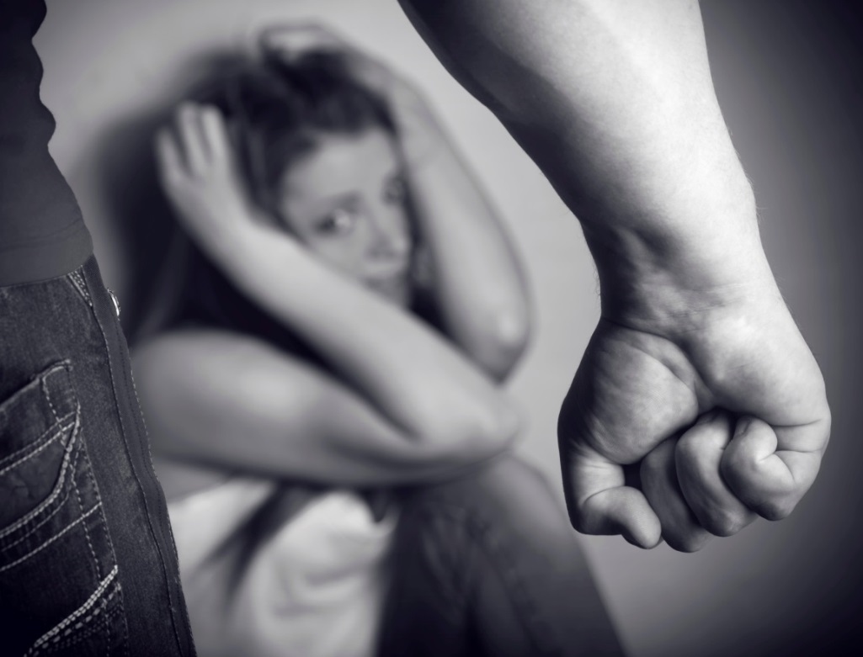
Abuser Behaviors
Abusers use violence and threats to establish power and control over their partners through fear and intimidation.
The abuser’s pattern of abusive acts is used to gain control and compliance of the victim.
The tactics are selectively chosen and purposeful.
It is impossible to appease abusers. They never have enough control over their victims.
Notes:
Family Violence: Legal, Medical, and Social Perspective

Slide 16

Different Types of Domestic Violence
Domestic violence often encompasses many different types of abuse. The violence can include:
  Physical Abuse
  Sexual Abuse
  Verbal Abuse
  Financial Abuse
  Stalking
The abuser uses whatever works to assert power and control through fear and intimidation.
Notes:
Why Victims Stay: IFVS Training

Slide 17
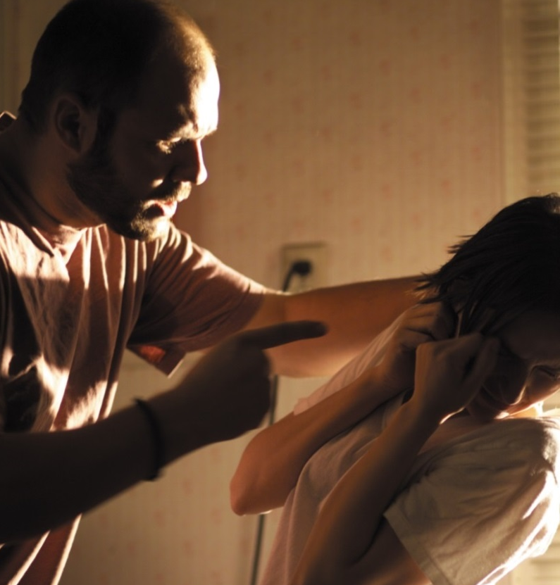
Physical Abuse
Physical abuse is the intentional use of physical force with the potential for causing injury, harm, disability, or death.
Punching, Slapping, and Hitting
Kicking, Cutting, and Stabbing
Weapon Use
Biting, Scratching, and Burning
Pushing and Shoving
Restraining, Strangling, and Holding Down
Notes:
CDC: IPV
Center for Relationship Abuse Awareness

Slide 18
Psychological/Emotional Abuse
Psychological or emotional abuse is any behavior that threatens, intimidates, undermines the victim’s self-worth or self-esteem, or controls the victim’s freedom.
Humiliation
Isolation
Degradation
Diminishing self-worth and self-esteem
Control of victim behavior
Blackmail
Intimidation
Notes:
CDC: IPV
Center for Relationship Abuse Awareness

Slide 19
Sexual Abuse
Sexual abuse is the use of physical force, coercion, or threats to force a person to have sex against his or her will.
Rape and sexual assault
Forcing the victim to watch or create pornography
Forced pregnancy
Forced anal or oral sex
Unwanted touching
Reproductive coercion
Notes:
CDC: IPV
Center for Relationship Abuse Awareness

Slide 20
Defining Sexual Assault and Rape
Sexual assault is the most inclusive term that includes sex-related behaviors from unwanted sexual contact through sexual intercourse.
Rape refers to some form of bodily penetration.
  Vaginal rape
  Anal rape
  Digital rape
  Oral rape
  Use of an object to penetrate
Check your state’s individual laws for more information.
Notes:
Family Violence Across the Lifespan

Slide 21
Economic/Financial Abuse
Economic abuse occurs when an abuser controls finances and the victim’s ability to obtain money or control over his or her finances.
Preventing the victim from having or keeping a job
Interfering with the victim’s efforts to maintain a job
  Sabotaging childcare, transportation, or other arrangements
Harassing the victim at work
Refusing to work
Not allowing the victim access to the family finances
Taking the victim’s money
Demanding an account of everything the victim buys
Controlling the victim’s access to financial information
Not allowing the victim’s name to be on accounts
Not allowing the victim to obtain health insurance, Medicare, welfare, disability, etc.
Notes:
Why Victims Stay: IFVS Training
Center for Relationship Abuse Awareness

Slide 22
Verbal Abuse
Verbal abuse is the perpetrator humiliating and threatening the victim.
Degrading the victim in front of friends and family
Telling hurtful “jokes” despite the victim’s requests to stop
Taking the victim’s statements out of context
Name calling
Insulting
Humiliation
Criticizing
Blaming
Accusing
Questioning the victim’s sanity
Threats of physical abuse
Coercing or forcing the victim to do things he or she does not want to do.
Notes:
Family Violence Across the Lifespan
Center for Relationship Abuse Awareness

Slide 23
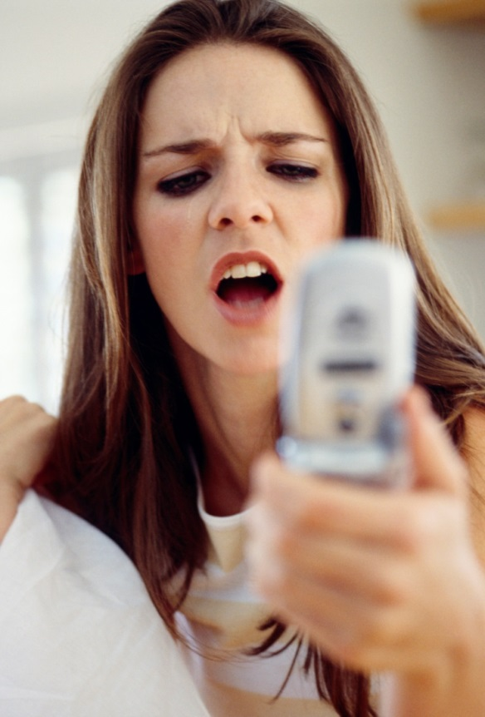
Stalking
Stalking is harassing or threatening behavior that an individual engages in repeatedly.
Stalking can be carried out in person or via electronic mechanisms.
Types of stalking behaviors include:
  Following a person
  Appearing uninvited at a victim’s home or work
  Harassing phone calls, text messages, and electronic messages
  Vandalizing property
  Giving constant unwanted gifts, messages, flowers, etc., to convince the victim to forgive or return to the abuser.
Notes:
Family Violence Across the Lifespan

Slide 24
Cyber-stalking
Cyber-stalking is the use of technology to stalk victims. It involves the pursuit, harassment, or contact of a victim in an unsolicited way initially via the internet and electronic devices.
Cyber-stalking may be used through:
Email: Constant emails harassing the victim
Chat rooms: Constant bombarding of messages
Social networking sites (Facebook, Twitter, Instagram): Following what the victim is saying, doing, and places he or she is visiting and sending repeated unwanted messages
GPS System (On-Star): Following the victim through access of his or her GPS
Portraying the Victim: Assuming the victim’s identity to portray him or her in a negative light online

Slide 25
Common Characteristics of Abusers
Medical professionals should know the following:
Most abusers are not mentally ill.
Abuse is not caused by anger management problems or stress.
Abusers deny responsibility of abuse and often blame the victim for the abuse.
Abusers choose to abuse victims.
Although abusers may have a substance abuse issue or have been abused in the past, this does not cause abuse.
Notes:
IFVS Perpetrator

Slide 26
Common Characteristics of Victims
Research has indicated that victims of domestic violence may demonstrate one or more of the following characteristics:
Many victims feel helpless and cannot safely leave an unhealthy relationship.
Many victims have been shamed or embarrassed about abuse, and keep it a secret to protect themselves.
Many victims fear for the safety of themselves, but also their children, family members, pets, and belonging.

Slide 27
Domestic Violence:
Often About Power and Control
Battering is one form of domestic violence that is characterized by the pattern of actions that someone uses to control or dominate his or her partner.
  The abuser systematically uses threats, intimidation, and coercion to create fear. These behaviors are the spokes of the wheel.
Physical and sexual violence are what holds the wheel together, creating the rim of the wheel.
Notes:
Duluth: http://www.theduluthmodel.org/training/wheels.html

Slide 28
Consequences of
Domestic Violence
Violence affects people and changes them forever. The most immediate feelings following domestic violence are a sense of helplessness, anger, anxiety, depression, and fear. Domestic violence can cause very serious health and mental health consequences. A few of the most common consequences are listed below.
Health
  Injuries to extremities
    Broken bones, cuts, scratches, bruises, strangulation marks
  Chronic pain
  Gastrointestinal problems
  Chest pain
  Gynecological problems
  Poor pregnancy outcomes
Mental Health
  Anxiety
  Depression
  PTSD
  Chronic Stress
  Alcohol/Drug abuse
For more information on negative physical and mental health conditions related to domestic violence, see the Basics of Screening Training at nationaltoolkit.csw.fsu.edu/medicalprofessionals/screening
Notes:
CDC: NISVS 2010 Summary Report

Slide 29
Why Some Victims Stay with Abusers
Fear of Further Violence Victims may fear that:
  There will be more abuse
  The abuser may carry out threats to kill
  The abuser may destroy her belongings
  Her reputation will be ruined
  The abuser may harm children, pets, and other family
  members
  She won’t be able to see children
  The abuser may kill the victim or him/herself
Isolation and Lack of Resources
Victims may have:
  No money or income
  No safe place to go to
  Few people to ask for help
  No transportation
  No ability to leave
The most dangerous time for a woman is immediately after leaving an abuser. Her risk of serious injury or death is highest at this time, when the abuser does not have access to her.
Notes:
Why Victims Stay: IFVS Training

Slide 30

Why Some Victims Stay with Abusers
Lack of Support:
  No friends or family to turn to
  Ashamed or embarrassed to ask for help
  Afraid of being alone
  Worry that they won’t be believed
Beliefs and Feelings:
  Feel responsible for abuse
  Love the abuser
  Have children with the abuser
  Religious or social beliefs that divorce is wrong
  Religious or social beliefs that must obey and support the man
Notes:
Why Victims Stay: IFVS Training

Slide 31
Victim Coping Mechanisms
  Minimizing: Downplaying the importance or severity of abusive behaviors
  Denial: Refusing to admit or pretends that abuse is not happening
  Rationalization: Victims find reasonable explanations for the abuser’s behavior
    Stress, work, lack of sleep
  Drug/Alcohol Use: Numb the pain from abuse
  Self Blame: Blame themselves for the actions of the perpetrators
Notes:
Why Victims Stay: IFVS Training

Slide 32
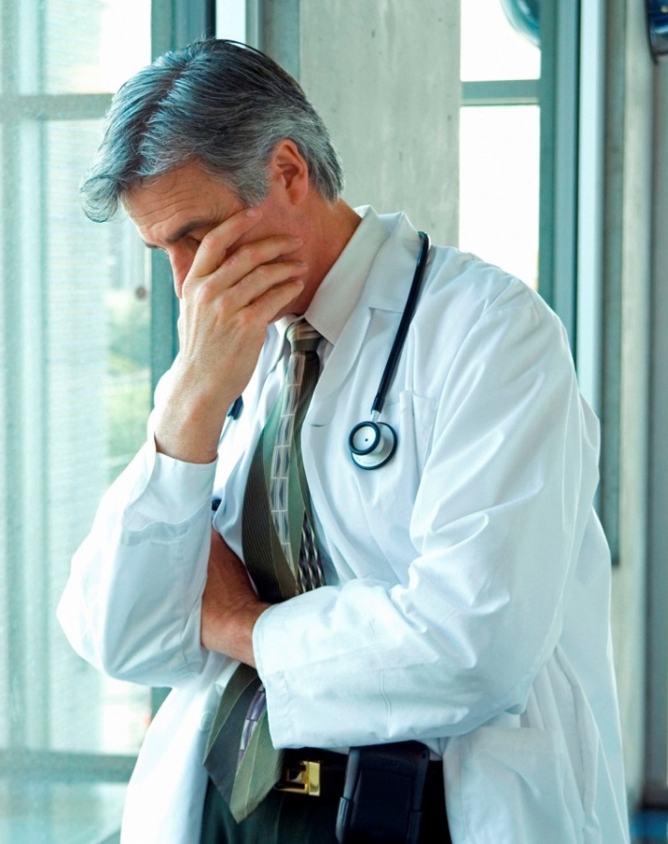
Avoiding Negative Reactions to Victims Who Don’t Leave
Many professionals who interact with victims become frustrated with victims.
They think victims are putting themselves in a dangerous situation and being reckless.
Medical professionals may suggest that the victim leave the abuser and when he or she doesn’t, consider him or her noncompliant.
Victims may not leave for a multitude of reasons, including that they do not know the resources available to them or are afraid of what could happen if they are caught.

Slide 33

Why Blaming the Victim is Wrong
People blame victims to distance themselves from domestic violence so they feel more in control of their own safety.
The problem of victim blaming is that it marginalizes the victim and makes it harder to come forward and report the abuse.
Victim-blaming attitudes also reinforce what the abuser has been saying to the victim: that it is the victim’s fault.
Victim blaming allows the abuser to perpetrate the victim while avoiding accountability.
It is NEVER the victim’s fault. It is always the abuser’s choice to take advantage of another human being.
Notes:
http://stoprelationshipabuse.org/educated/avoiding-victim-blaming/

Slide 34
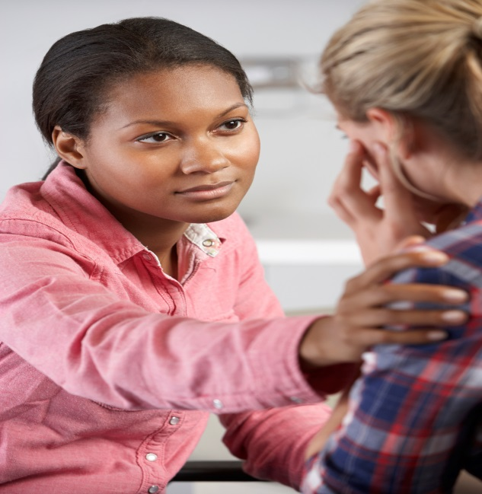
Prevention of
Domestic Violence
For medical professionals, preventing domestic violence includes educating patients about is and helping victims access resources to help stop it.

Slide 35
Prevention:
What Medical Professionals Can Do
Medical professionals can help victims of domestic violence by:
Screening patients for domestic violence.
  Many medical associations have recommended screening patients for domestic violence, including the following: The American Medical Association, the American Academy of Family Physicians, American Academy of Neurology, American College of Emergency Physicians, American College of Nurse-Midwives, American College of Obstetricians and Gynecologists, American Nurses Association, American Public Health Association, Emergency Nurses Association, American Medical Association, American Dental Association, and the American Academy of Orthopaedic Surgeons
Please view the training “Screening Patients for Domestic Violence” to learn more about the importance of screening.
Notes:
Family Violence Across the Lifespan

Slide 36
Prevention:
What Medical Professionals Can Do (continued)
Medical professionals can help victims of domestic violence by:
Understanding the definition and dynamics of domestic violence
Explaining to all patients that no one deserves to be abused
Providing all patients with information about community resources
Understanding why victims may stay with their abusers and why this does not mean they are noncompliant with professional requests
Understanding how to screen patients for domestic violence victimization
Learning how to follow up with patients who are victimized by their partners
Knowing the resources available in the community so that they can be recommended to help victims
Evaluating your own attitudes on abuse and how you feel and think about victims and abusers
Notes:
Family Violence Across the Lifespan

Slide 37
Community Resources | How Medical Professionals Can Help
Shelters: Place of temporary refuge and support for women escaping violent or abusive situations | Become familiar with shelters in your community. Obtain a contact of an advocate at the shelter. Connect patients directly with the advocate.
Injunctions: Court orders that require a party to do or refrain from doing specific acts | Connect patients with someone who can assist them in the injunction process (usually an advocate or a police department or agency)
Crisis Intervention: Emergency psychological care to assist individuals in a crisis situation to restore balance to their biopsychosocial functioning | Become familiar with crisis hotlines in your area. Provide information to patients on these services and allow them to call when and if they are ready.

Slide 38
Resources | How Medical Professionals Can Help
Advocacy: Provide a range of supportive services to help individuals involved in domestic abuse situations to become self-sufficient | Connect patients with advocates in the community, through hotlines, or in your own medical facility. Advocates can include domestic violence workers, counselors, social workers, psychologists, etc.
Safety Plan: Coming up with a detailed plan on how to leave an abuser safely | Connect patients with a shelter advocate or domestic violence hotline advocate to help plan.
Law Enforcement: Some victims may seek the assistance of law enforcement. | Talk with patients about the option of calling law enforcement. Do not force patients to report abuse. If you are a mandatory reporter, let patients know if you will be contacting law enforcement.

Slide 39
The National Domestic Violence Hotline
If you or a patient have any questions about domestic violence, or need help, call:
1-800-799-7233

Slide 40
Conclusion
Domestic violence can affect anyone, no matter their gender, race, ethnicity, sexual orientation, or socioeconomic background.
It is a preventable health problem.
Medical professionals should be willing and able to take steps to inform patients about domestic violence and community resources to address it.

Slide 41
References
Family Violence Across the Lifespan
  Barnett, O. W., & Perrin, R. D. (2011). Family violence across the lifespan: An introduction (3rd ed.). Los Angeles, CA: Sage Publications, Inc.
Family Violence: Legal, Medical, and Social Perspectives
  Wallace, H. (1996). Family violence: Legal, medical, and social perspectives (6th ed.). Boston: Allyn and Bacon.
DV101: Dynamics of Domestic Violence
  http://training.familyvio.csw.fsu.edu/manuals/dv101/index.php?content=index
Futures Without Violence
  http://www.futureswithoutviolence.org/content/action_center/detail/754
Center for Disease Control: Intimate Partner Violence
  http://www.cdc.gov/violenceprevention/intimatepartnerviolence/index.html
Center for Disease Control: Fact Sheet
  http://www.cdc.gov/violenceprevention/pdf/ipv_factsheet2012-a.pdf
NISVS 2010 Summary Report
  http://www.cdc.gov/violenceprevention/pdf/nisvs_executive_summary-a.pdf
National Coalition Against Domestic Violence
  http://www.ncadv.org/protectyourself/MyPersonalSafetyPlan_131.html
Center for Relationship Abuse Awareness
  http://stoprelationshipabuse.org/educated/types-of-abuse/sexual-abuse/

Slide 42
You Have Completed the
Basic Training!

